Slide 1
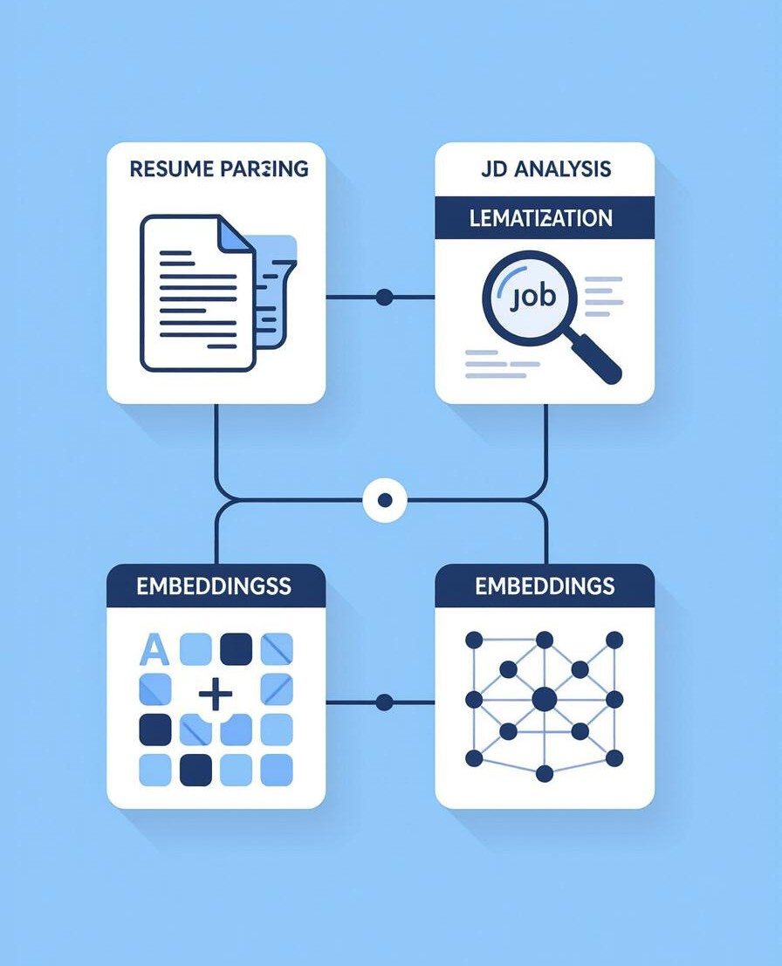
Project Overview: AI-Powered Resume Parser
This project automates resume data extraction using AI, streamlining recruitment processes and providing
real-time insights.
Purpose: To efficiently convert unstructured resume data into a structured, usable format.
Importance: Enables rapid candidate screening, improves data accuracy, and accelerates recruitment workflows.
Benefits: Reduces manual data entry, enhances analytical capabilities, and supports data-driven decision-making in HR.

Slide 2

Document Upload & Processing
The system supports a variety of input formats and incorporates rigorous validation checks.
Supported Formats: PDF, DOCX, TXT, JPG/PNG (with OCR).
Validation Features:
  File size limit (e.g., 10MB).
  Malware scanning using ClamAV or similar.
  Format verification to ensure compatibility and prevent processingerrors.

Slide 3

AI-Powered Data Extraction
Leveraging NLP and regex-based techniques, the system extracts key information accurately.
Data Points Extracted:
  Contact Details: Name, email, phone number, address.
  Work Experience: Job titles, company names, dates of employment, responsibilities.
  Education: Degrees, institutions, graduation dates.
  Skills: Technical and soft skills.
  Professional Summary: Overview of qualifications and career goals.

Slide 4
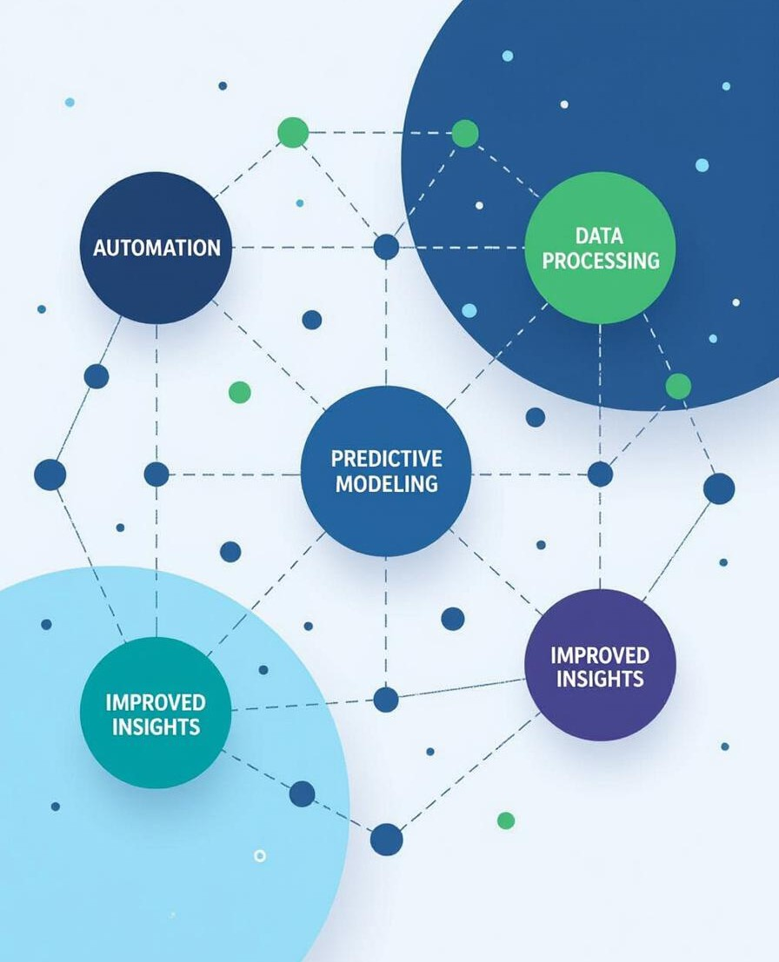
AI Enhancement Features
Advanced AI capabilities enrich the extracted data and provide deeper insights.
Intelligent Classification: Automatically categorizes resume sections and identifies relevant information.
Context Understanding: Uses NLP to interpret the context of text and accurately extract information.
Data Enrichment:
  Company Lookups: Integrates with APIs to fetch company details (size, industry).
  Skill Normalization: Standardizes skill entries (e.g., "Python" instead of "python," "Python programming").
  Career Analysis: Predicts career trajectory based on historical data.

Slide 5
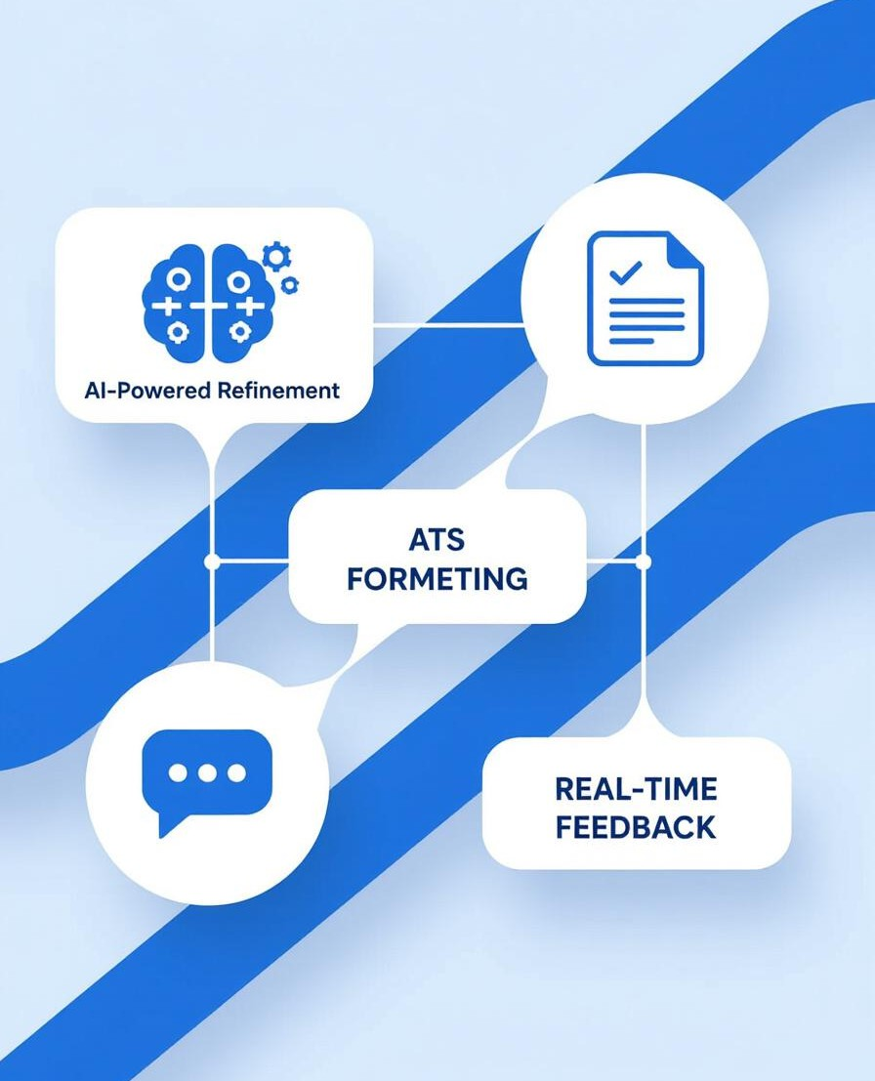
System Architecture & Tech Stack
System Diagram: Note: In a real presentation, this section would include a visual diagram showing the flow of data from document upload to final output. Due to the text-only format, this part is described below.]
Document Upload → Pre-processing s Validation
→ Data Extraction (AI/NLP) → Data Enrichment → Database Storage → API Access
Core Technologies:
AI/ML: TensorFlow, PyTorch, Hugging Face Transformers, OpenAI API
Backend: FastAPI (Python), Django (Python), Node.js
Database: PostgreSQL, MongoDB
Processing Tools: PyPDF2, Tesseract OCR
Deployment: Docker, Swagger UI for API documentation

